Slide 1
Logistic Regression
Chapter 7

Slide 2
Reference
http://www.cnblogs.com/BYRans/category/719322.html
http://www.cs.toronto.edu/~hinton/
https://en.wikipedia.org/wiki/Multinomial_logistic_regression
https://www.cs.ox.ac.uk/people/nando.defreitas/machinelearning/
http://www.tuicool.com/articles/faMVfq

Slide 3
Outline
Logistic regression
Softmax regression

Slide 4
Logistic Regression
Logistic regression
Softmax regression
Name is somewhat misleading. Really a technique for classification, not regression.
  ‘Regression’ comes from fact that we fit a linear model to the feature space.
A single-layer perceptron or single-layer artificial neural network(we will see it in the ANN chapter).

Slide 5
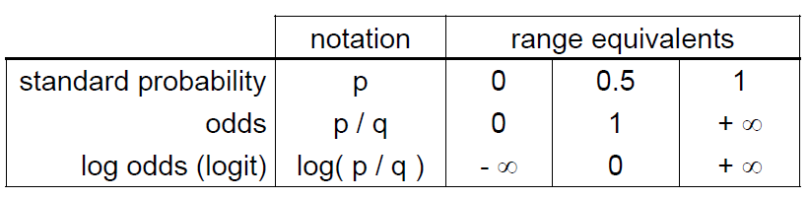
Different ways of expressing probability
Logistic regression
Softmax regression
Consider a two-outcome probability space, where
  p(O1)=p
  p(O1)=1-p=q
Can express probability of O1 as:

Slide 6
Log odds
Logistic regression
Softmax regression
Numeric treatment of outcomes O1 and O2 is equivalent
  If either outcome is favored over the other, then log odds=0
  If one outcome is favored with log odds =x, then other outcome is disfavored with log odds= -x.

Slide 7
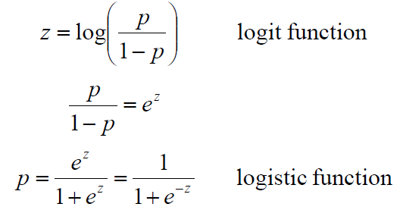
Probability to log odds (and back again)
Logistic regression
Softmax regression

Slide 8
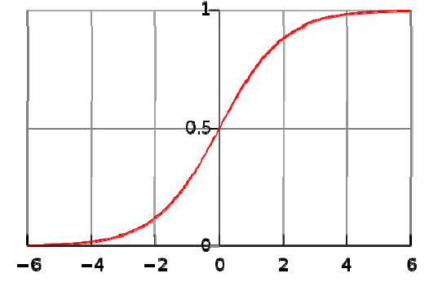
Logistic fuction
Logistic regression
Softmax regression

Slide 9
Using Scenario
Logistic regression
Softmax regression
Scenario:
  A multidimensional feature space (features can be categorical or continuous)
  Outcome is discrete, not continuous.
    We’ll focus on case of two classes here.
  It seems plausible that a linear decision boundary (hyperplane) will give good predictive accuracy.

Slide 10

Using a logistic regression model
Logistic regression
Softmax regression
Model consists of a vector β in d-dimensional feature space
For a point x in feature space, project it onto β to convert it into a real number z in the range -∞ to + ∞
Mapt z to the range of 0 to 1 using the logistic funciton
Overall, logistic regression maps a point x in d-dimensional feature space to a value in the range of 0 to 1.

Slide 11
Using a logistic regression model
Logistic regression
Softmax regression
Can interpret prediction from a logistic regression model as:
  A probability of class membership
  A class assignment, by applying threshold to probability
    Threshold represents decision boundary in feature space.

Slide 12
Training a logistic regression model
Logistic regression
Softmax regression
Need to optimize β so the model gives the best possible reproduction of training set labels
  Usually done by numerical approximation of maximum likelihood
  On really large datasets, may use stochastic gradient descent

Slide 13
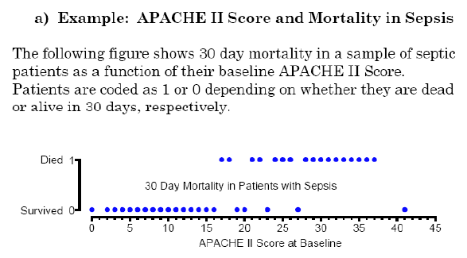
Examplse
Logistic regression
Softmax regression

Slide 14
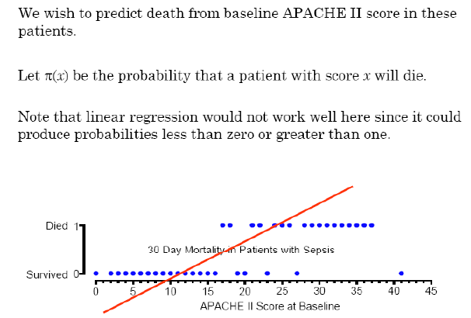
Examples
Logistic regression
Softmax regression

Slide 15
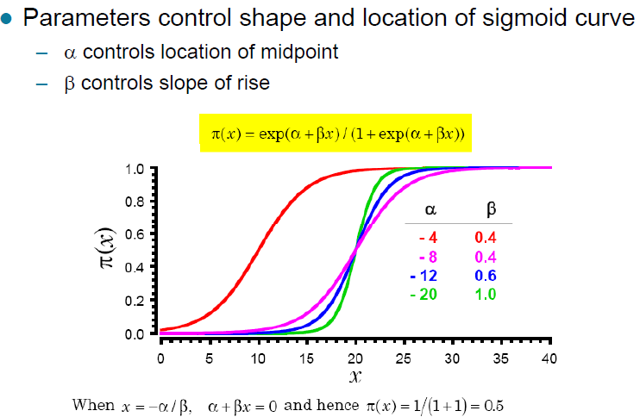
Examples
Logistic regression
Softmax regression

Slide 16
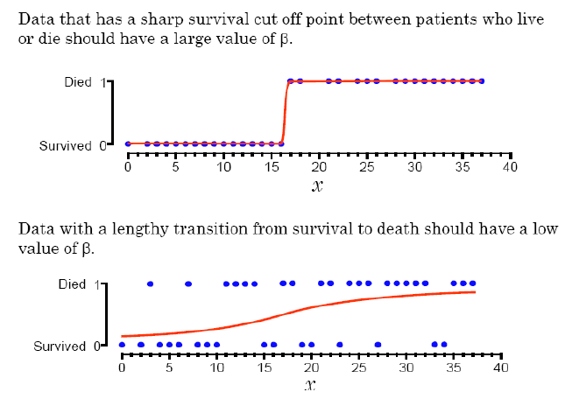
Examples
Logistic regression
Softmax regression

Slide 17
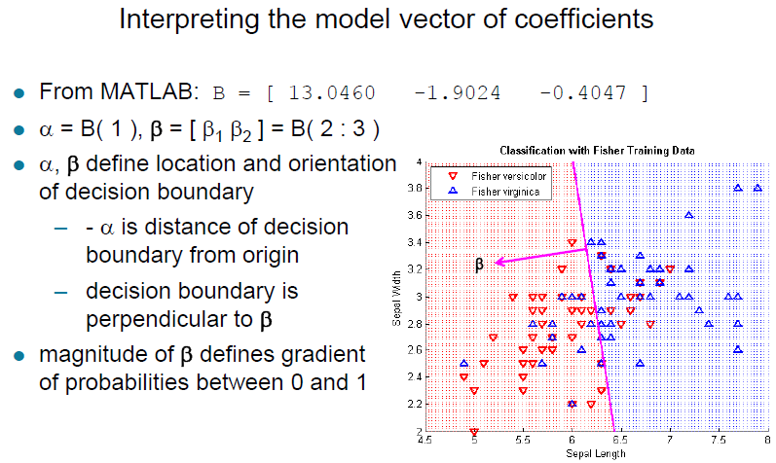
Examples
Logistic regression
Softmax regression

Slide 18
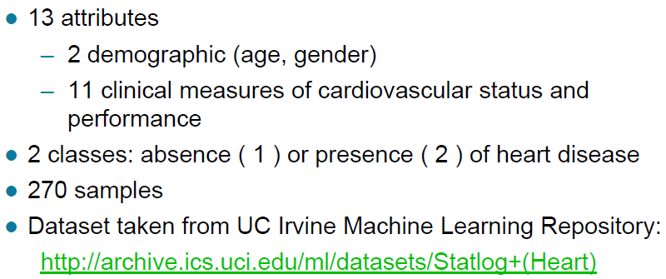
Heart disease dataset for test
Logistic regression
Softmax regression

Slide 19
Advantages and disadvantages
Logistic regression
Softmax regression
Advantages:
  Makes no assumptions about distributions of classes in feature space
  Easily extended to multiple classes (later)
  Natural probabilistic view of class predictions
  Quick to train
  Fast at classifying unknown records
  Good accuracy for many simple data sets
  Resistance to overffiting
  Can interpret model coefficients as indicators of feature importance
Disadvantages:
  Linear decision boundary

Slide 20
Softmax Regression
Logistic regression
Softmax regression
Main reference:
http://deeplearning.stanford.edu/wiki/index.php/Softmax_Regression

Slide 21

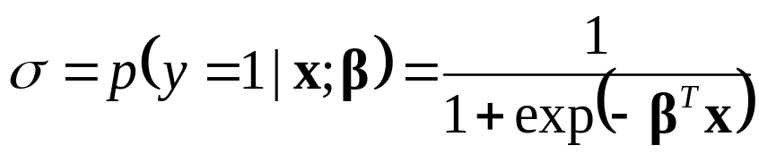
Logistic Regression recall
Logistic regression
Softmax regression
We had a training set of m labeled examples, where the input features are {(x⁽¹⁾,y⁽¹⁾), (x⁽²⁾,y⁽²⁾),…, (x^{(N)},y^{(N)})} . ( letting the feature vectors x be M + 1 dimensional, with x₀ = 1 corresponding to the intercept term). With logistic regression, we were in the binary classification setting, so the labels were y . Our hypothesis took the form:
Where σ is the probability of x belonging to the positive class y=1.

Slide 22
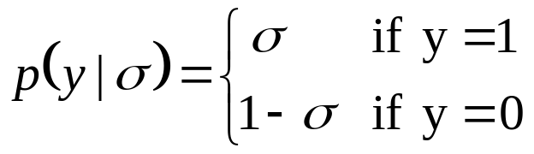

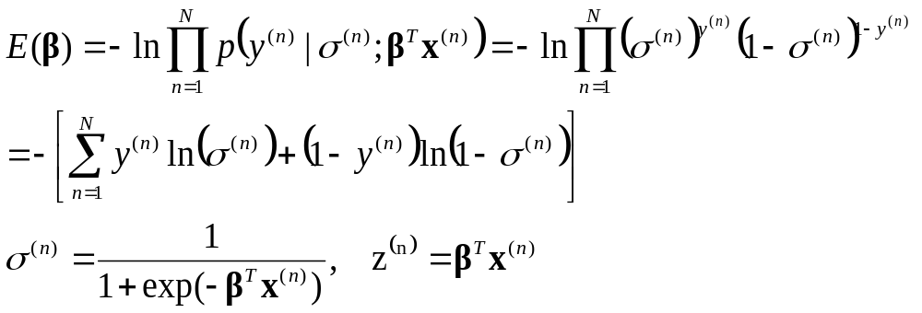
Logistic Regression recall
Logistic regression
Softmax regression
Suppose y is a Bernoully random variable that takes the value {0,1}, then the probability can be written as
Furtherly we can rewrite the probability more succinctly as follows
So we can get parameter β by minimizing such a cost function

Slide 23
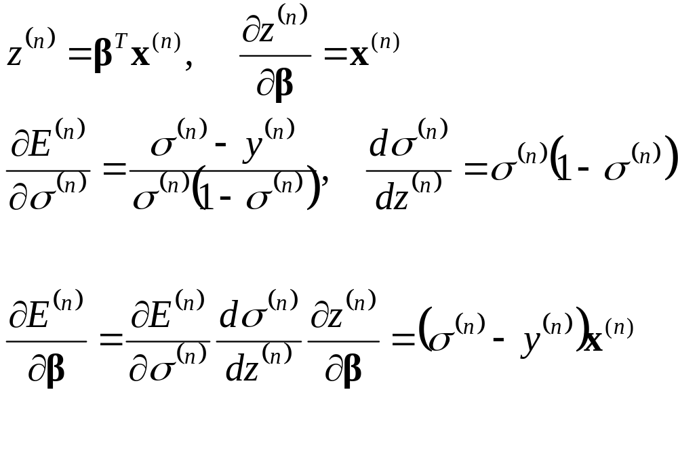
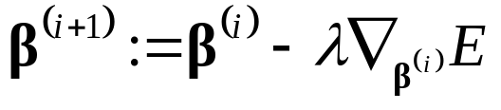
Using the chain rule to get the error derivatives
Logistic regression
Softmax regression
Then a gradient descending method can be used to estimate the β as follows:

Slide 24
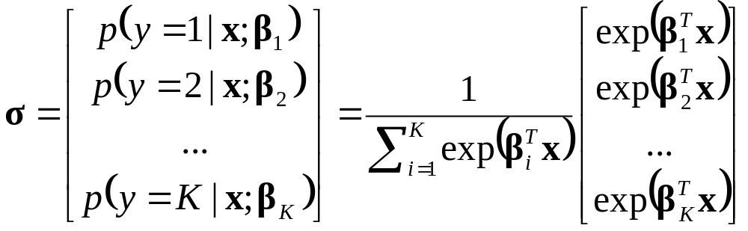
Softmax Regression
Logistic regression
Softmax regression
With Softmax regression, we were in the multiclass classification setting, so the labels were {1,….,K}. Our hypothesis took the form:
Where we get all probabilities of input x belonging to class 1 to K.

Slide 25
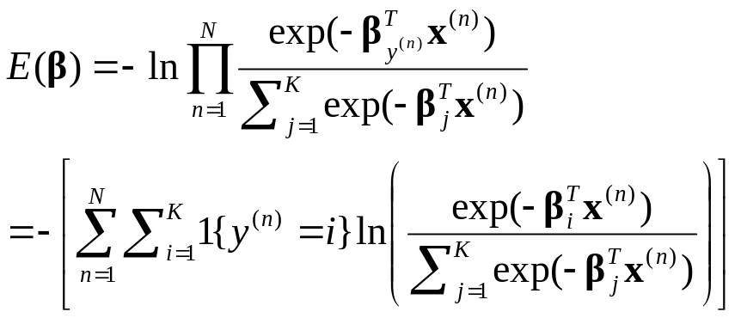
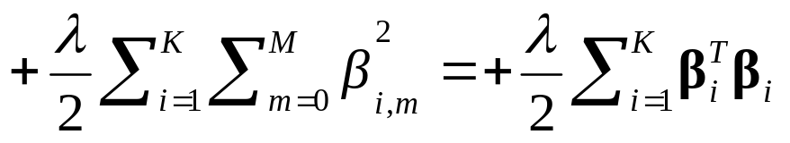
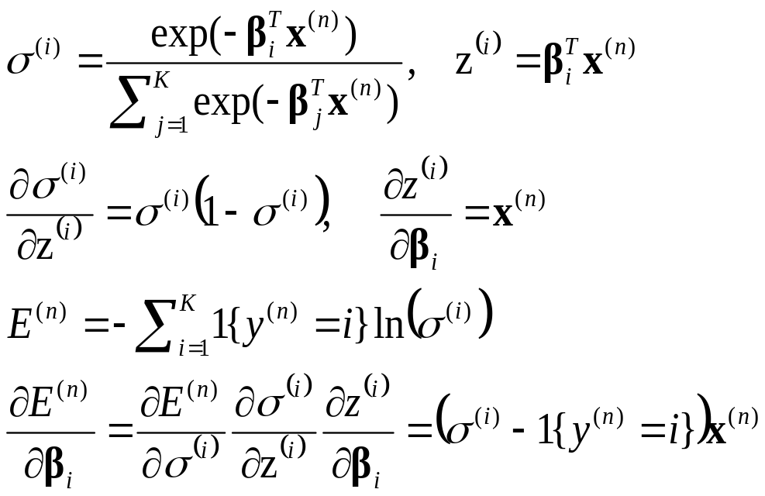
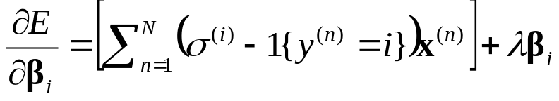

Softmax Regression
Logistic regression
Softmax regression
??
This term is added to make the cost function E() strictly convex. It penalizes the large values of parameters.
Then a gradient descending method can be used to estimate all the
这一步是怎么过来的？？？

Slide 26
Softmax vs. K bianary classifier
Logistic regression
Softmax regression
Now, consider a computer vision example, where you're trying to classify images into three different classes.
  (i) Suppose that your classes are indoor_scene, outdoor_urban_scene, and outdoor_wilderness_scene. Would you use sofmax regression or three logistic regression classifiers?
  (ii) Now suppose your classes are indoor_scene, black_and_white_image, and image_has_people. Would you use softmax regression or multiple logistic regression classifiers?
In the first case, the classes are mutually exclusive, so a softmax regression classifier would be appropriate. In the second case, it would be more appropriate to build three separate logistic regression classifiers.

